Slide 1

Meshing Monolith to Microservices
Leo Liang
@leozc
Notes:
Image from:https://www.lucidchart.com/documents/edit/7a670700-e347-4b51-9eb7-3a0a898b7cee/5

Slide 2


About Me
@leozc
https://www.linkedin.com/in/leoliang
https://github.com/leozc
Engineer Manager
Machine Learning Platform
Ground Truth

Slide 3
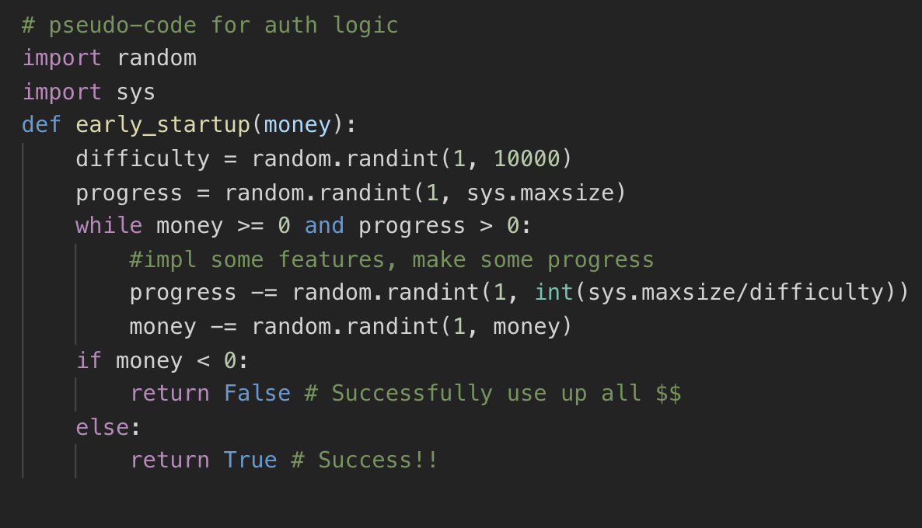
How startup works
If a startup can be described in (python) code....
Notes:
This page accepts the fact that it is normal to start with monolith

Slide 4
Scale enables faster and more meaningful iterations
“
Any organization that designs a system (defined more broadly here than just information systems) will inevitably produce a design whose structure is a copy of the organization’s communication structure.
— Conway’s law 1967
To Maximize per_day_iteration_throughput
Scale Teams (Quality + Quantity)
Scale Architecture
Notes:
Explain the meaning of scale Ensure arch is correct before arranging teams and org

Slide 5
How the story began
Journey started in the beginning of 2016
LinkerD released first version :)
High growth Seattle unicorn - Offerup
2016 10 engineers VS 2017 100+ engineers
2016 A BIG fat Monolith VS 2018 40+ services
100% native on AWS
Solution => Service Mesh driven Microservice architecture evolution

Slide 6
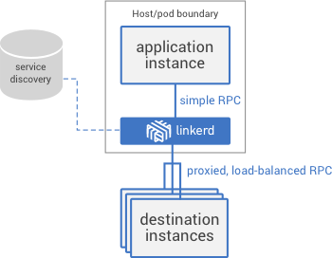
What is LinkerD (v1)
A proxy
managing, controlling, and monitoring
LinkerD = L5D
Built on Twitter Stack
Netty, Finagle, Scale (JVM)
Dtab (Delegation tables) is DSL for routing
NamerD DNS for LinkerD Mesh
Powerful plugin support
JVM languages (Java, Scala)
For clarity - presudo code in python

Slide 7
This talk is about...
The architecture evolution from monolithic to microservice driven by service mesh
Pragmatic and systematic solution
Imperfect solution but respects the legacy context :)

Slide 8
Agenda
Edge - Split the world into two
Core of Mesh - Service to Service Communication
Observability
Conclusion

Slide 9
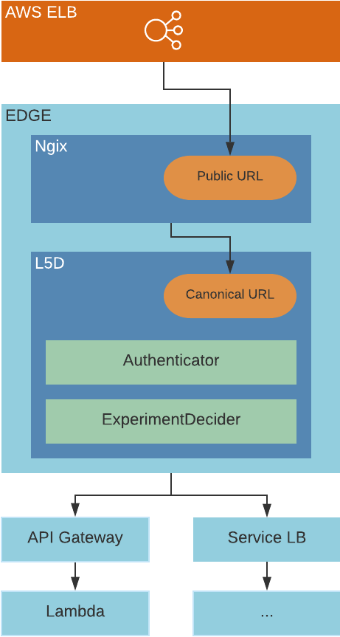


Split the world into TWO
Edge = Nginx + (Linkerd + Customized Plugins)
Notes:
https://www.lucidchart.com/documents/edit/7a670700-e347-4b51-9eb7-3a0a898b7cee/0

Slide 10
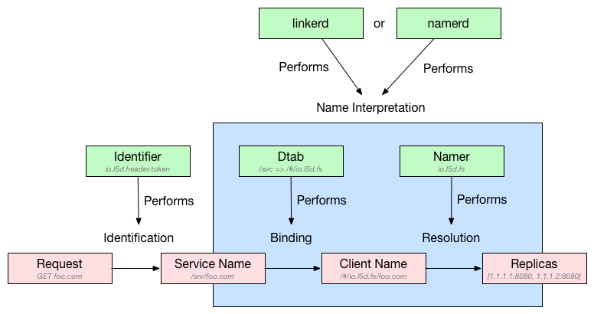
Split the world into TWO
Edge = Nginx + (Linkerd + Customized Plugins)
Notes:
https://www.lucidchart.com/documents/edit/7a670700-e347-4b51-9eb7-3a0a898b7cee/0

Slide 11
Split the world into TWO
Nginx Layer
Police and security (CSRF validation)
Header Normalization and injection (region)
URL Normalization
/api/message/foo/bar?a=123
/h1/us-east-1a/prod/foo/bar?a=123

Slide 12
Split the world into TWO
LinkerD Layer
URL Interpreted by Namerd Dtab
NamerD → Mesh DNS
/h1/us-east-1a/prod/foo/bar?a=123 will deliver traffic to:
$host:$port/foo/bar?a=123
(Note: Routing/Discovery in later section)

Slide 13
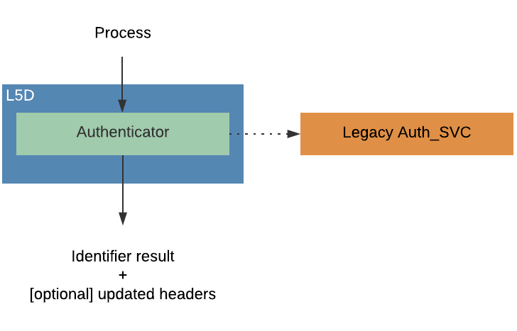
Edge LinkerD - Authentication
Transition
Legacy Client using cookie
Newer Clients using JWT
Ensure downstream services to have trusted user identify
Inject per user-specific context (e.g., user group)

Slide 14
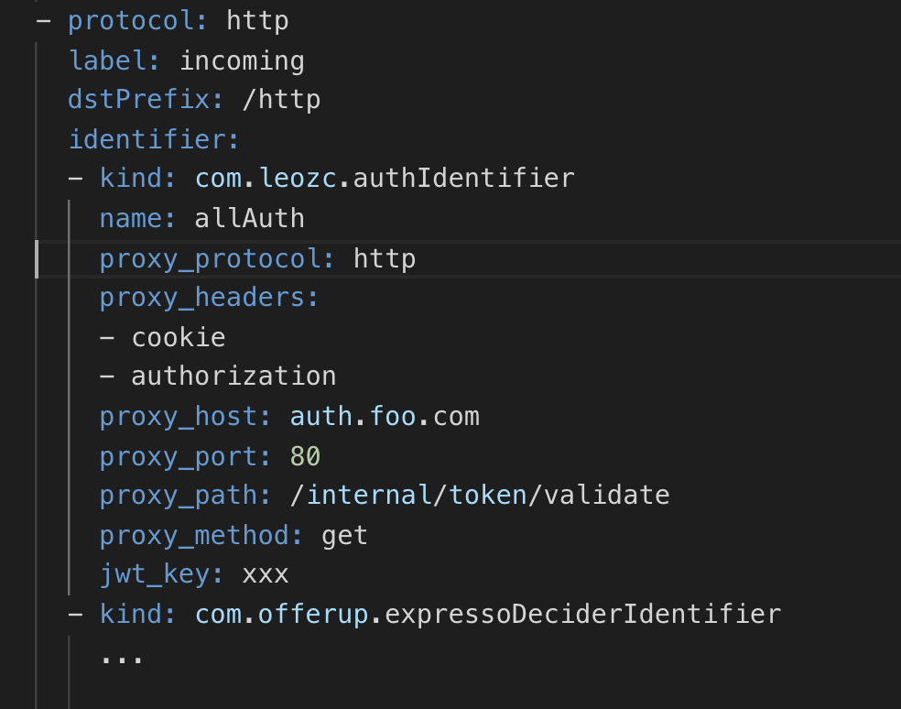
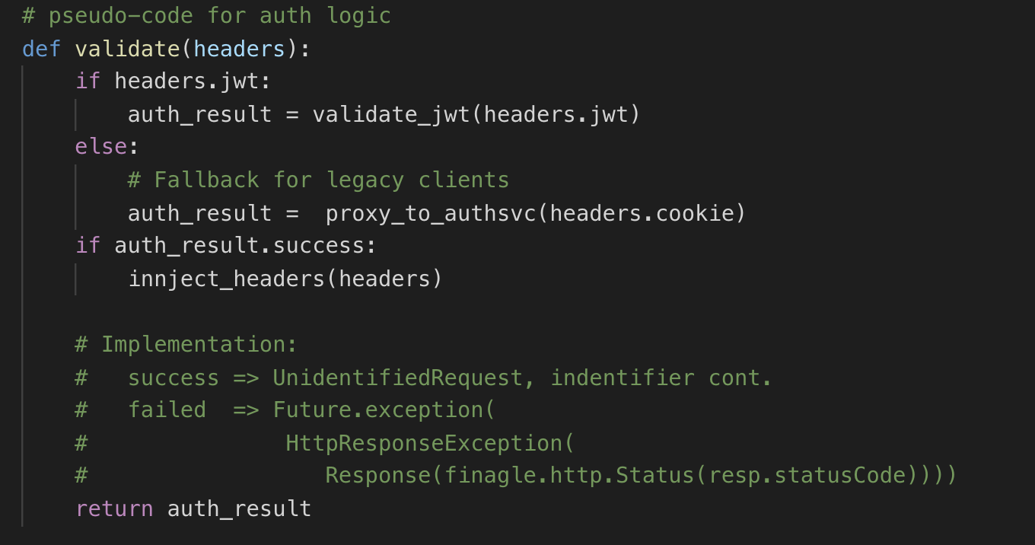
Edge LinkerD - Authentication
A LinkerD Identifier Plugin

Slide 15
Split the world into TWO

Slide 16
Edge LinkerD - Canary on Edge
ExperimentDecider
Experiment, Service rollout
Per service based
Split traffic based on some criterial
User Id, group
Controlled rolling out
/h1/dc1/prod/messaging
=> 0.5 * /h1/dc1/prod/messaging & 0.5 * /h1/dc1/canary/messaging

Slide 17
Edge LinkerD - Canary on Edge
Dtab
/h1/dc1/prod/svc1 => /h1/dc1/canary/svc1
/h1/dc1/prod/messaging
=> 0.5 * /h1/dc1/prod/messaging & 0.5 * /h1/dc1/canary/messaging
Notes:
Delegation tables (dtabs for short) are lists of routing rules that take a “logical path” and transform it into to a “concrete name” where that thing is located (e.g., 2790 Harrison St, San Francisco, CA 94110). This is a process we call “resolution” and it happens via a series of prefix rewrites.

Slide 18
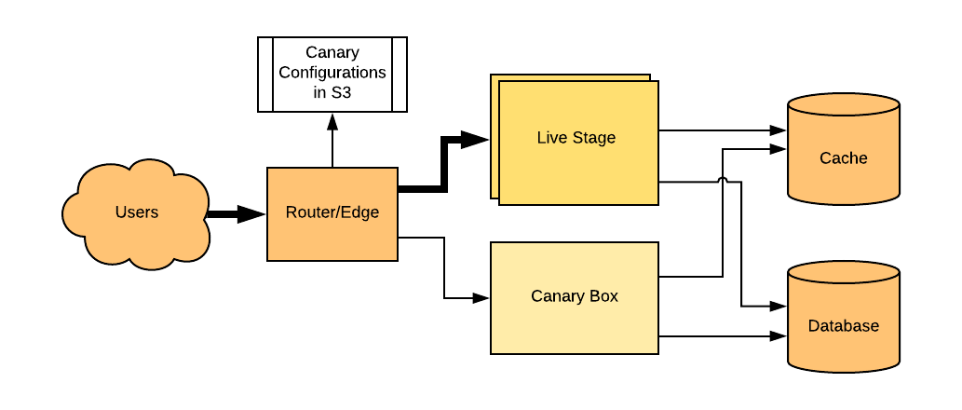
Edge LinkerD - Canary on Edge
Canary helps the roll out!

Slide 19
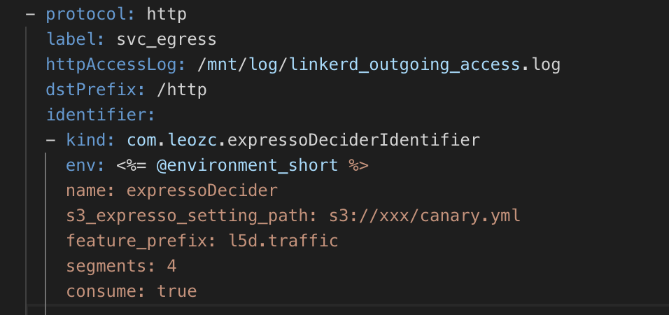
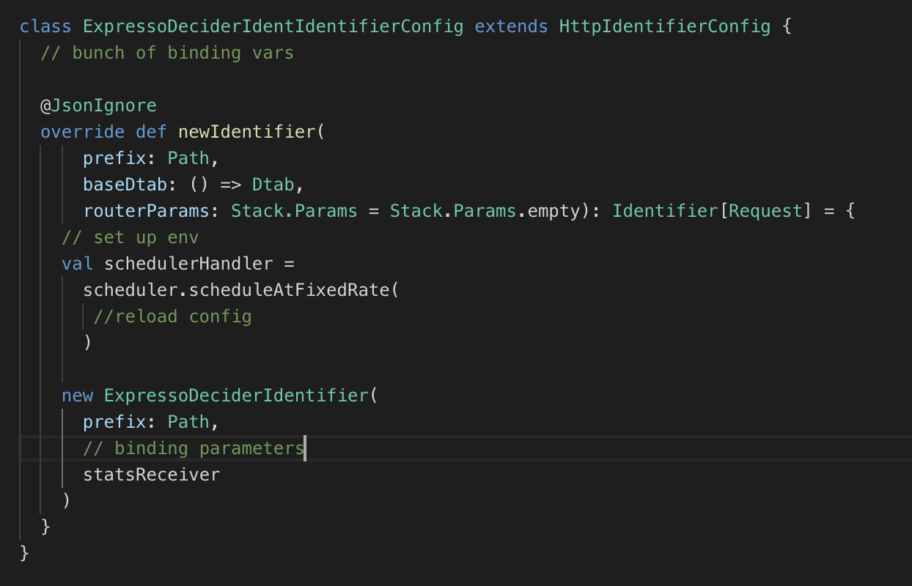
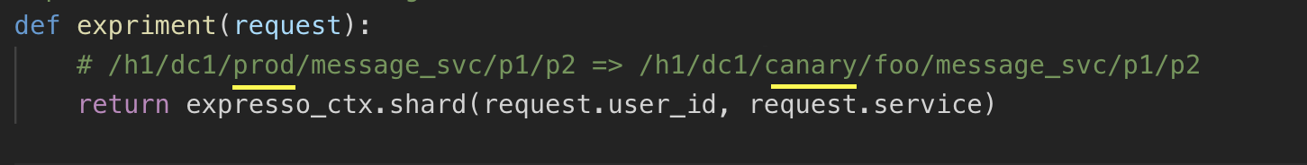
Edge LinkerD - Canary on Edge
Config
ExpressoDeciderIndentifier inherits io.l5d.path
Per Request Eval pseudo code

Slide 20
Summary: Split the world into TWO
Pros
Horizontal scale ready
Separate external and internal APIs and policies
All external APIs are measured by L5D (Observability in later of the talk)
Flexibility Nginx + LinkerD
Cons
Double passing for all inbound traffic
(Free) Nginx lacks of control plate unlike L5D, but L5D provides some level of controlling features.

Slide 21
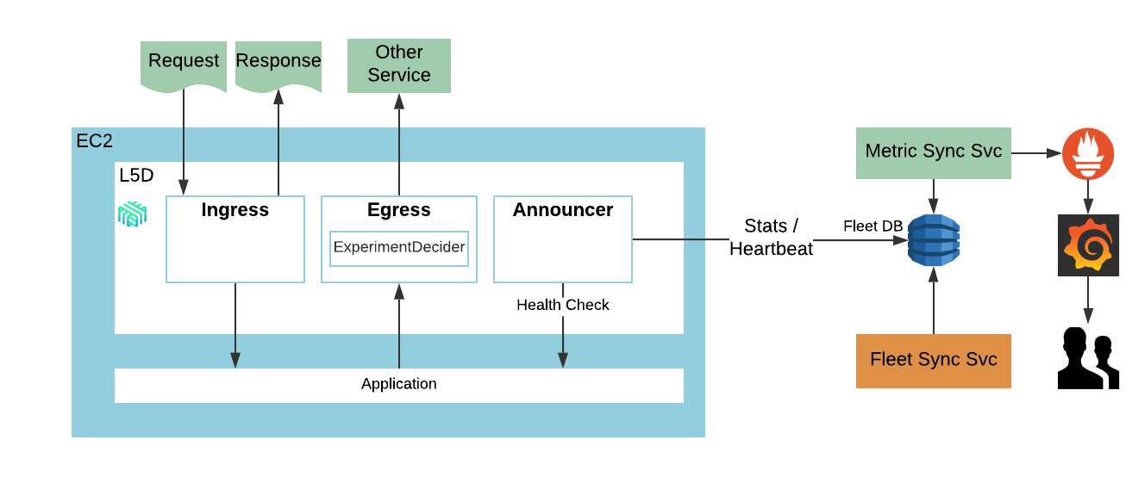
Service to Service Communication
Let’s get into the mesh!

Slide 22
Service to Service Communication
Supported protocols
HTTPv1
Thrift
Why ingress/egress through LinkerD?
Connection policy control (retry/backout)
Connection pool
Circuit breaking
Etc...

Slide 23
Service to Service Communication

Slide 24
Service to Service Communication
How services talks to each other?
Discovery v1
Consul based registry
Linkerd Uses consul
Ingress point is ELB
Discover v2
Peer to Peer
Client based LB
Notes:
Linkerd has versatile load balancing algorithms for minimizing service latencies and improving overall success rate. While these algorithms only work the best under a point-to-point topology, such that Linkerd can continuously evaluate the status of each target service node. When a service node latency goes up, Linkerd may throttle the traffic delivered to that node. That brings two benefits, keeping service latencies low, allowing the node in trouble to recover. On the other hand, ELB being the middleman shuffles traffic and obscures the service nodes. That makes Linkerd blind in terms of optimizing traffic routing. For that sake, we plan to take ELB and Consul service registration out of our service mesh landscape in a long run.

Slide 25
Service to Service Communication
What is Service discovery
Service name -> [address:port]
Consistency, availability, fault tolerance (CAP)
EC2 ASG
Lacks on central place to map services → $hosts:$port
Fleet of each service scales independently
EC2 API is power but VERY limited

Slide 26

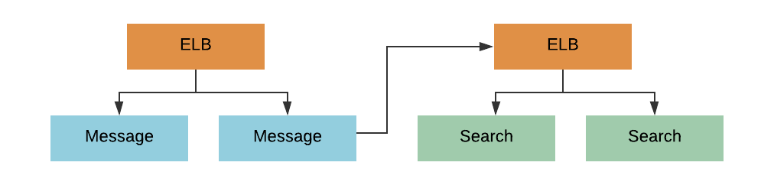
Service to Service Communication - Discovery V1
Discovery v1 - OOB, shortest path for impl
Each service fronted by an ELB
DTab #/io.l5d.consul/dc/$env/$service_name
Namerd uses this information and query consul
$service_name maps to an ELB in consul

Slide 27
Service to Service Communication - Discovery V1
Per host Consul agent?
Complexity:
Another utility to maintain in additional of L5D sidecar
another DNS system overlay on AWS (Route53)
Consul was 0.8.

Slide 28
Service to Service Communication - Discovery V1
All GOOD!
But we can do better!
Features in L5D is per host
e.g. Retry budget
Imbalance routing

Slide 29
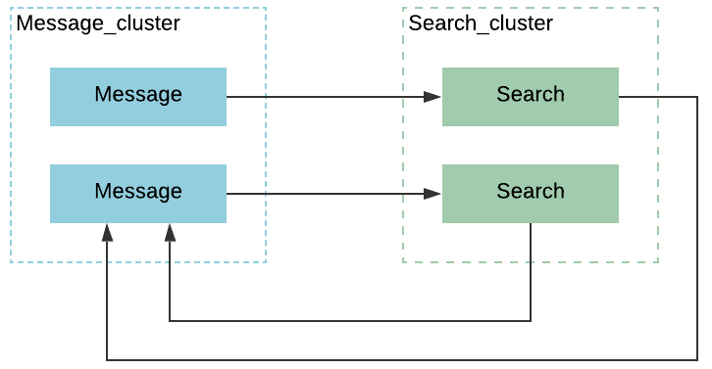
Service to Service Communication - Discovery V2
Discovery v2 - SRV based routing
Peer to Peer
Powerful LB algorithms
Heap + Least Loaded, Power of Two Choices (P2C) + Least Loaded, Power of Two Choices (P2C) + Peak, EWMA Aperture + Least Loaded
DTab /#/io.l5d.dnssrv/dc1/$env/$service_name.foo.com
$service_name.foo.com is SRV record
Notes:
Linkerd Has very powerful LB policies

Slide 30
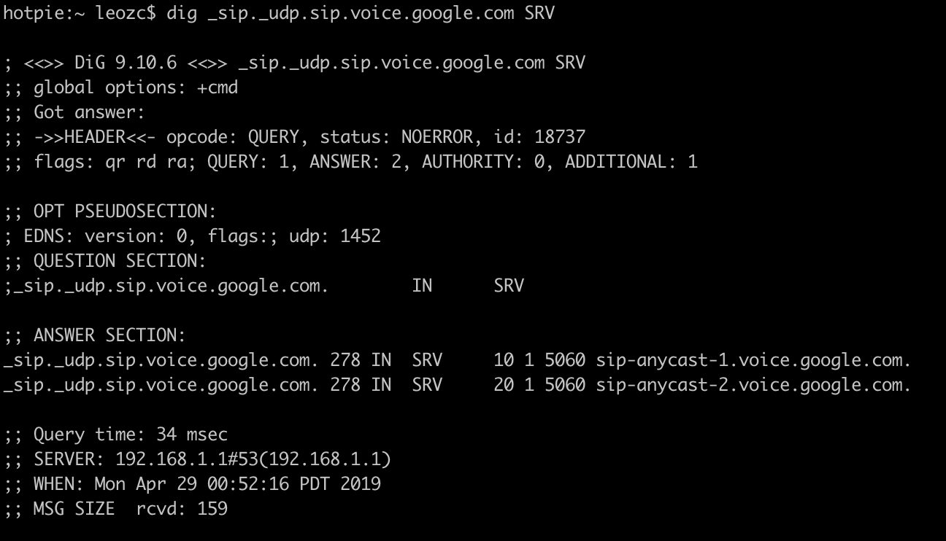
Service to Service Communication - Discovery V2
What is SRV – how does it work?
CName for a GROUP of machines
Format: Priority Weight Port Host/IP
Example: 10 5 80 172.0.0.4

Slide 31
Service to Service Communication - Discovery V2
Nodes automatically register to Route53 as an SRV record (Announcer)
NamerD returns all IPs of a SRV to LinkerD
LinkerD performs load balancing across all these IPs
Fleet Sync Svc
hocks up signals of fleet (e.g. EC2 shutdown event)
Rip off outdated info

Slide 32
Service to Service Communication - Discovery V2
Consistency - Eventual
Availability - Strong
Fault tolerance - Strong

Slide 33
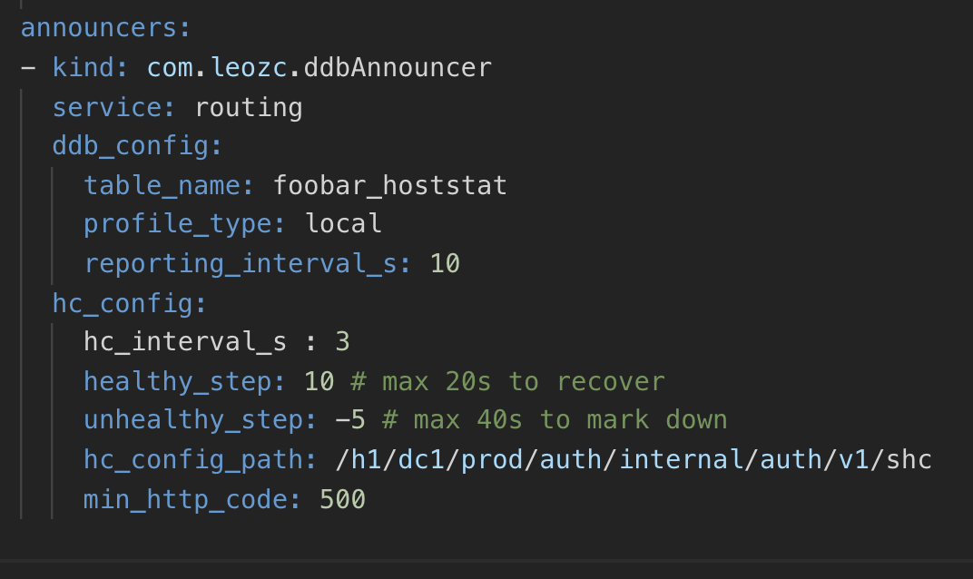
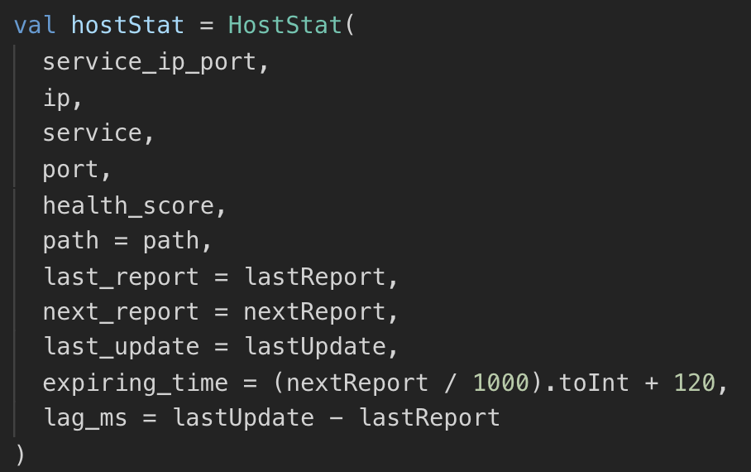
Service to Service Communication - Discovery V2
Record Stored in FleetDB

Slide 34
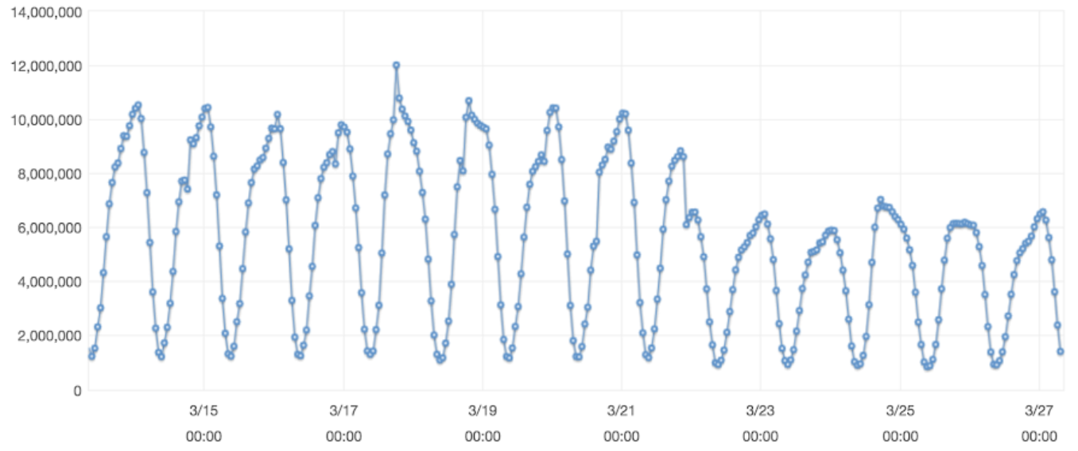
Service to Service Communication - Discovery V2
Discovery v2 - SRV based routing
Peer to Peer
DTab /#/io.l5d.dnssrv/dc1/$env/$service_name.foo.com
$service_name.foo.com is SRV record
New Connection between two production services reduced significantly due to proper connection pooling via L5D

Slide 35
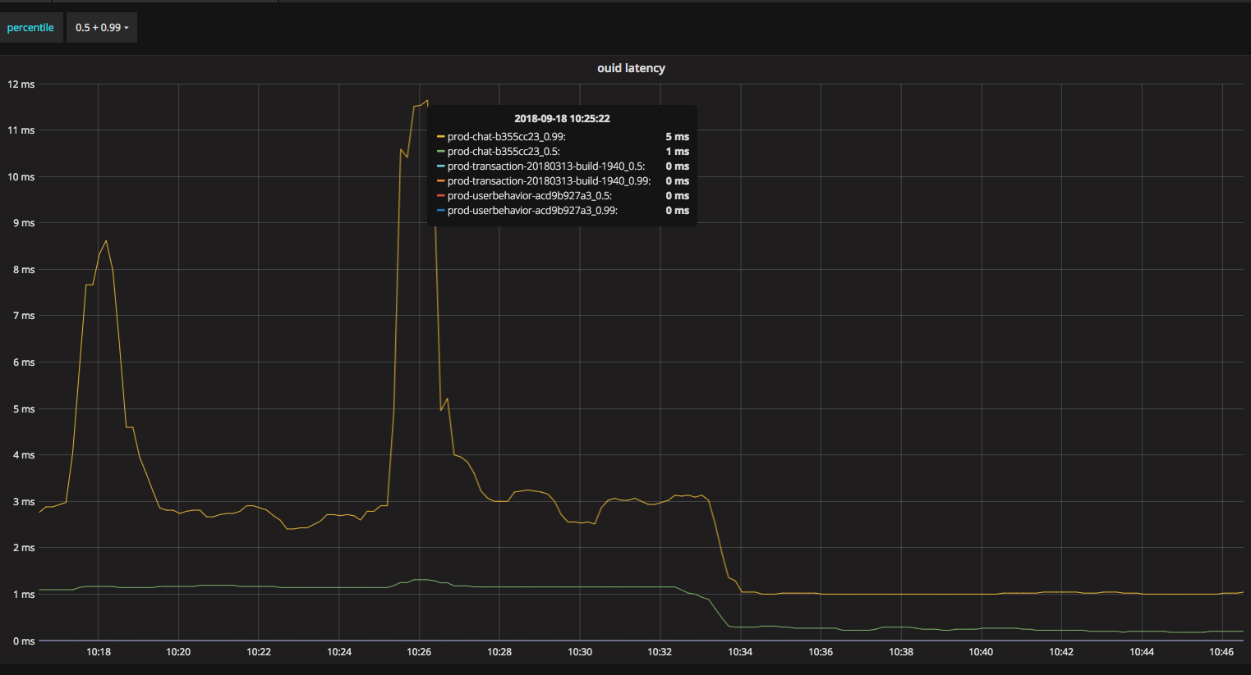
Discovery V1 vs Discovery V2
Notes:
Latencies
Let’s do the case study on a Thrift service. When the service was transitioned from ELB to SRV, we can see clearly that SRV outperforms ELB, which doesn’t surprise us here. Long tail (P99) latency of SRV dropped to the level of what ELB P50 was (from 3ms -> 1ms). SRV P50 latency is well below 1ms (~0.2ms). This proves our hypothesis that ELB itself adds 1–2ms latency (on average) for every request. Moreover, the random latency spikes in ELB are gone in SRV. ( from the graph below: 10:34 we shift the traffic from ELB to SRV)

Slide 36
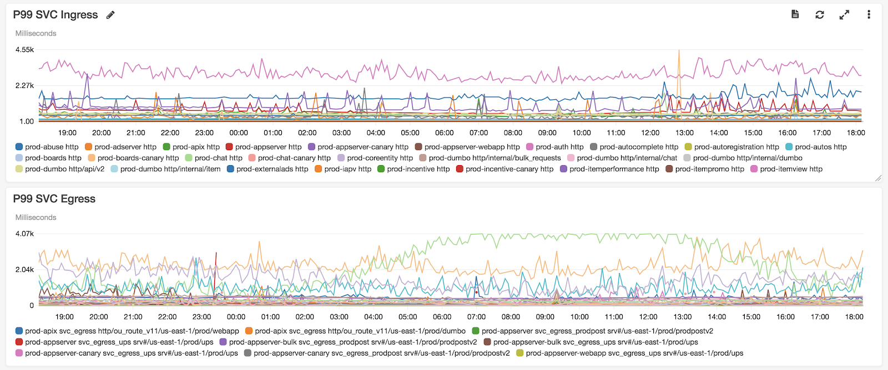
Service to Service Communication - Discovery V2

Slide 37
Discovery V1 vs Discovery V2
Discovery V1
Discovery V2

Slide 38
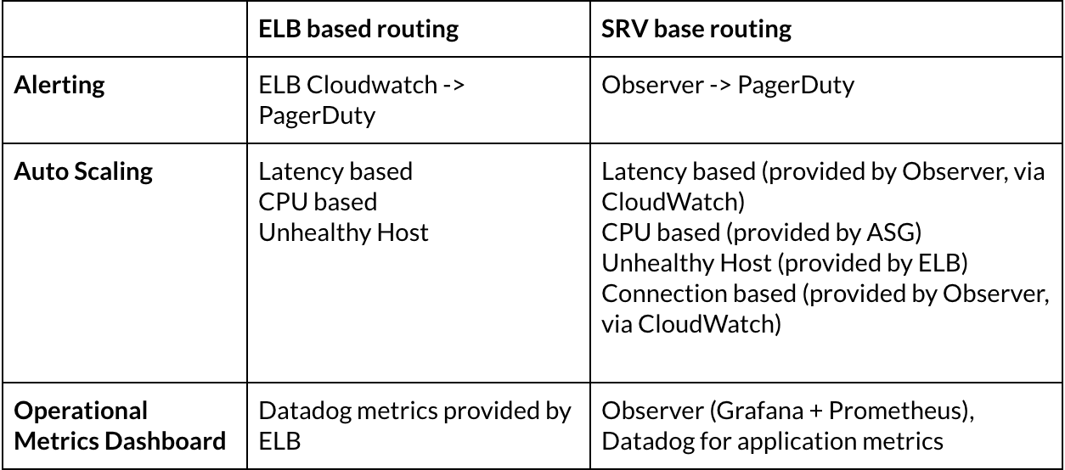
Discovery V1 vs Discovery V2

Slide 39


Observability

Slide 40
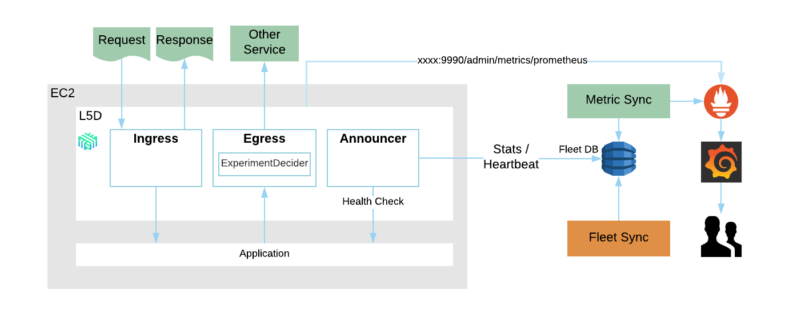
Observability

Slide 41
Observability
500K metrics
10 seconds intervals
40+ services
Some metrics published to Cloudwatch which integrated with alarm flow.

Slide 42
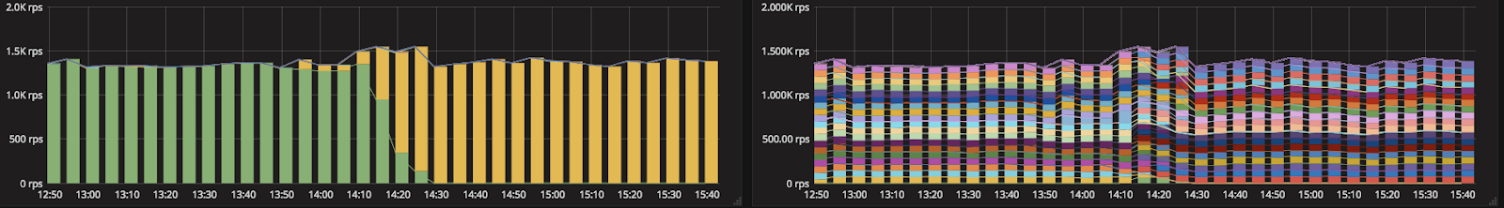
Observability - Gallery
Traffic shift from an old build to a new one during deployment

Slide 43
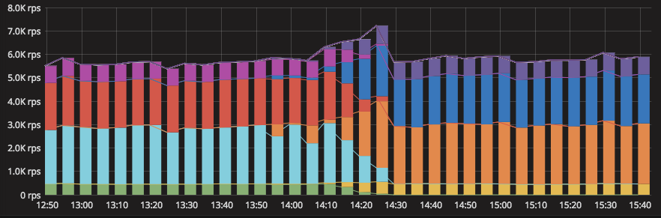
Observability - Gallery
Breakdown for HTTP Code and dependent services for Outbound Calls

Slide 44
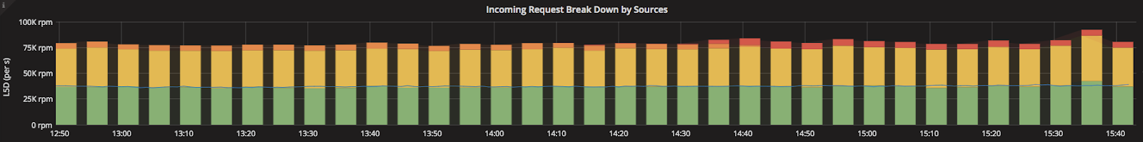
Observability - Gallery
A dashboard shows the incoming traffic breakdown by sources, with each color indicating a source of service

Slide 45
Conclusion
All inbound/outbound traffics are observable by L5D
A/B test is possible by having a plugin implemented by L5D
All traffic between any two nodes are controllable by L5D using Dtab
All Service communication is point to point
Consistent and sophisticate traffic/connection policies for ALL services implemented in ANY language
Ability to partial blank out a service
/h1/dc1/prod/messaging => 0.5 * /h1/dc1/prod/messaging & 0.5 /$/fail
JVM 9+ better GC – solve majority of long tail latency issues

Slide 46
Thank you!
@leozc

